Slide 1

深度学习与人工智能课程作业
2020. 春夏

Slide 2
题目八选一，如果某一题选题人数过多，会被调剂
Topic eight choose one. If there are too many people in a certain topic, it will be dispensed.
2. 以小组为单位合作完成，每组不多于3人
Work in groups of no more than 3
3. 提交内容，提交时间，提交方式，考核标准各个题目不同，详见说明文档
Submission content, submission time, submission method and assessment standard are different. Please refer to the instruction document for details
综述

Slide 3
选题一：基于小数据的对象识别
Topic 1: object recognition based on small dataset

Slide 4
选题一
题目简介
利用深度学习技术，在小量数据集上完成猫，狗，人三分类任务的训练和测试
具体要求
训练集中的猫，狗，人三类的图片每种不能超过150张。
但不对训练预训练模型的数据集规模做要求。
最终的测试仅对猫，狗，人的三分类效果进行测试。
由一张图片旋转，镜像，平移得到的图片视为多张而非视为一张
图片保存格式应为普通图片格式（png,jpg），每张图片为80×80的灰度图
深度学习框架建议为pytorch，TensorFlow

Slide 5
Topic 1
brief
Training and testing of cat, dog and human classification tasks on a small amount of dataset by using deep learning technology
content
No more than 150 pictures of cat, dog and human in the training center. But there is no requirement for the data set size of training pre training model. The final test only tests the effect of cat, dog and human.
Rotate, mirror and translate one image to get multiple images instead of one
The image saving format shall be normal image format (PNG, JPG), and each image shall be 80 × 80 gray-scale image
Recommend using pytorch，TensorFlow

Slide 6
选题一
本项目不以最终的三分类结果好坏作为唯一标准，具体见下
考核的首要指标是工程的完整情况，报告撰写的清晰情况。
考核的第二指标为算法的创新情况，自己是否进行思考是比测试结果更重要的！
考核的第三指标为测试结果
考核标准
提交文件
大作业报告（.doc/.pdf）。包括但不限于代码运行指南，算法描述，文件组织结构，结果展示等
工程代码
数据集
上述文件打包压缩为（.zip）

Slide 7
Topic 1
This project does not take the final three classification results as the only standard. See the following for details：
The primary criteria of assessment is the completion of the project and the clearance of report writing.
The second criteria of evaluation is the innovation of algorithm. Self-thinking is more important than test result!
The third criteria of assessment is the test result
Assessment criteria
Deliverable
Report fille（.doc/.pdf）。Including but not limited to code operation guide, algorithm description, file organization structure, result display, etc
Code
dataset
Compress all file into（.zip）

Slide 8
选题二：数据分布不均匀的对象识别
Topic 2: object recognition with uneven dataset

Slide 9
选题二
题目简介
利用深度学习技术，完成猫，狗，人三分类任务的训练和测试。但三者的训练数据量差异巨大
具体要求
训练集中的猫，人两类的图片每种不能少于300张（不设上限），狗的照片不能多于50张（不设下限）
不对训练预训练模型的数据集规模做要求
由一张图片旋转，镜像，平移得到的图片视为多张而非视为一张
图片保存格式应为普通图片格式（png,jpg），每张图片为80×80的灰度图
深度学习框架建议为pytorch，TensorFlow

Slide 10
Topic 2
The training and testing of cat, dog and human classification tasks are completed by using deep learning technology, but the training data of the three tasks are greatly different
Brief
No less than 300 pictures of cat and human in the training set (no upper limit), and no more than 50 pictures of dog (no lower limit)
Rotate, mirror and translate one image to get multiple images instead of one
The image saving format shall be normal image format (PNG, JPG), and each image shall be 80 × 80 gray-scale image
Recommend using pytorch，TensorFlow
content

Slide 11
选题三：图像到图像的特征迁移
Topic 3: feature transfer from image to image

Slide 12
选题三
题目简介
人有戴眼镜的时候也有不戴眼镜的时候，有人喜欢自己瘦一点，也有人希望自己胖一点。你能完成他们之间的转化吗？
具体要求
网络输入输出均要求直接为图片
以下任务四选一：
把不戴眼镜的人输入，输出戴眼镜的样子；
把戴眼镜的人输入，输出为不带眼睛的样子；
把人脸照片输入，输出瘦一点的样子。
把人脸照片输入，输出为胖一点的样子
数据集请大家自由构建，需随代码一起提交
深度学习框架建议为pytorch，TensorFlow

Slide 13
Topic 3
Some people like to be thinner and some want to be fatter when they wear glasses or not. Can you complete the transformation between them?
Brief
Network input and output are required to be pictures directly
Choose one of the following four tasks ：
Input the person without glasses, output the appearance with glasses；
Input the people with glasses and output the appearance without glasses；
Input the face photo and output a thinner look；
Input the face photo and output a fatter look
Please build the dataset freely and submit it with the code
Recommend using pytorch，TensorFlow
Content

Slide 14
选题四：多分辨率卫星地图中识别湖泊，河流
Topic 4: recognition of lakes and rivers in multi-resolution satellite map

Slide 15
选题四
题目简介
利用深度学习技术，对于输入的卫星图片，统计湖泊的个数，判断是否有河流
具体要求
首先，请大家自行收集，标注数据集，并确定数据的标注方法。是仅仅标注有/无，还是标注个数，还是标注坐标，还是像素级别的标注？只要有你的道理，只要证明可行且有效，就会被认为是优秀的结果
第二，训练网络，对输入的图片判断是否有湖泊，有几个。判断是否有河流

Slide 16
Topic 4
Using deep learning technology, for the input satellite images, count the number of lakes and determine whether there are rivers
Brief
First of all, please collect and label the data set, and determine the data labeling method. Is it just to mark with / without, or number, or coordinate, or pixel level? As long as there is your reason, as long as it is proved feasible and effective, it will be regarded as an excellent result
Second, training network, judging whether there are lakes in the input pictures, there are several. Judge whether there is a river
Content

Slide 17
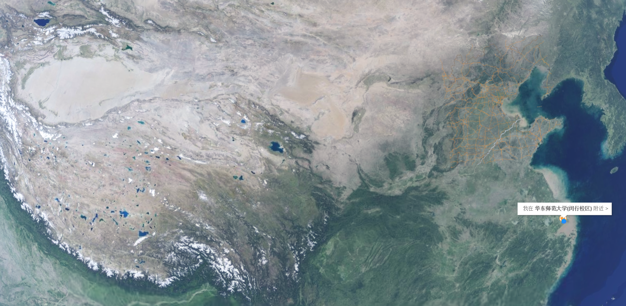
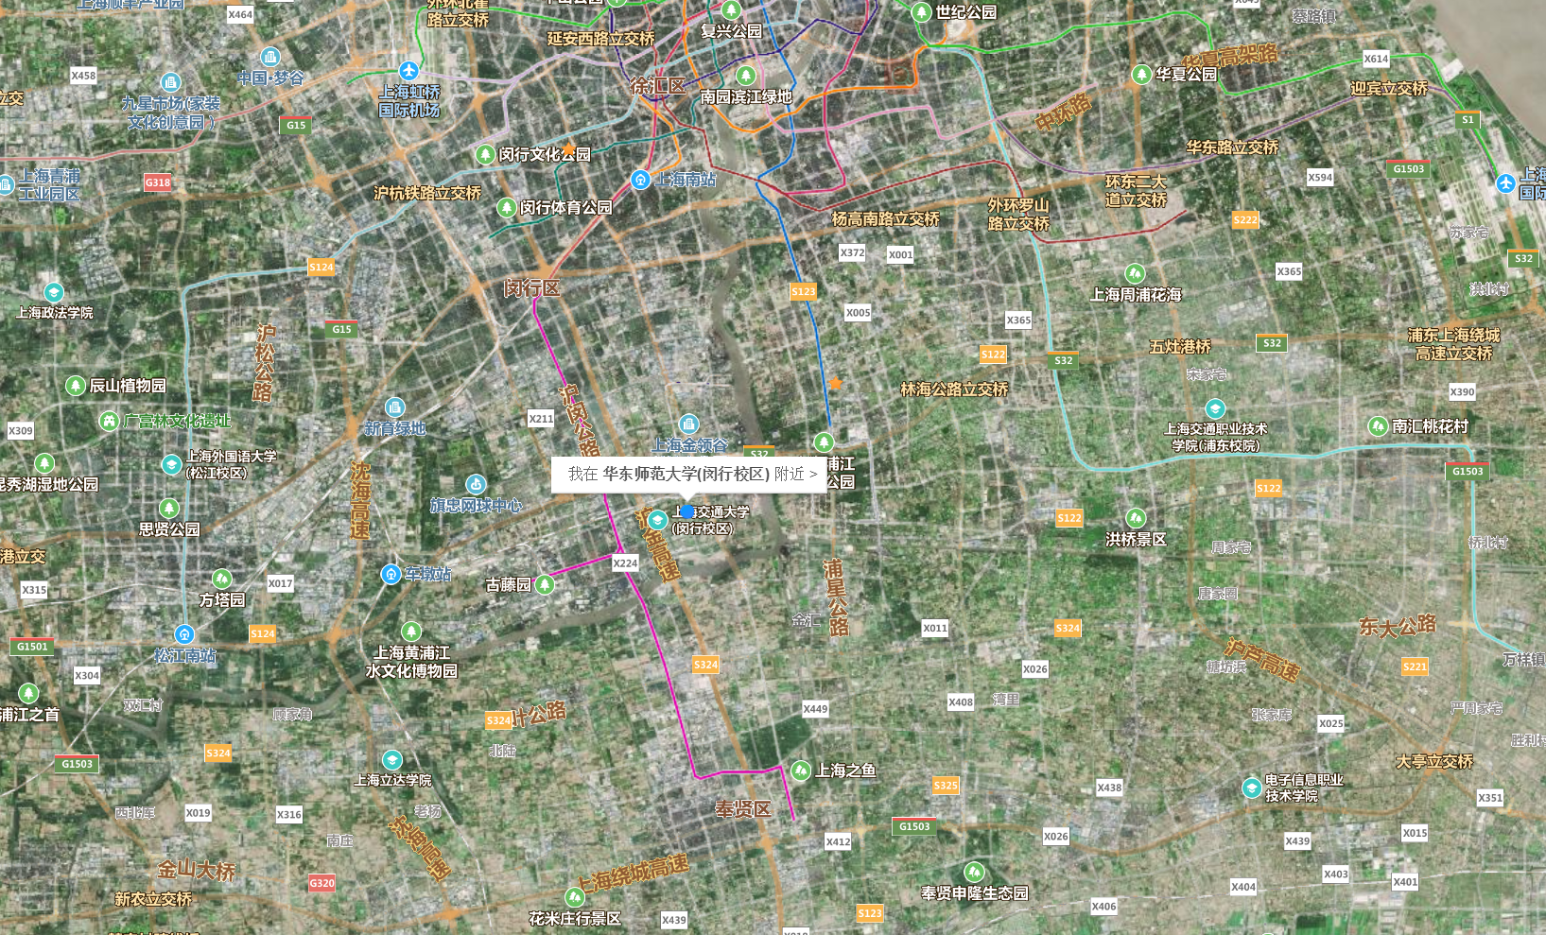
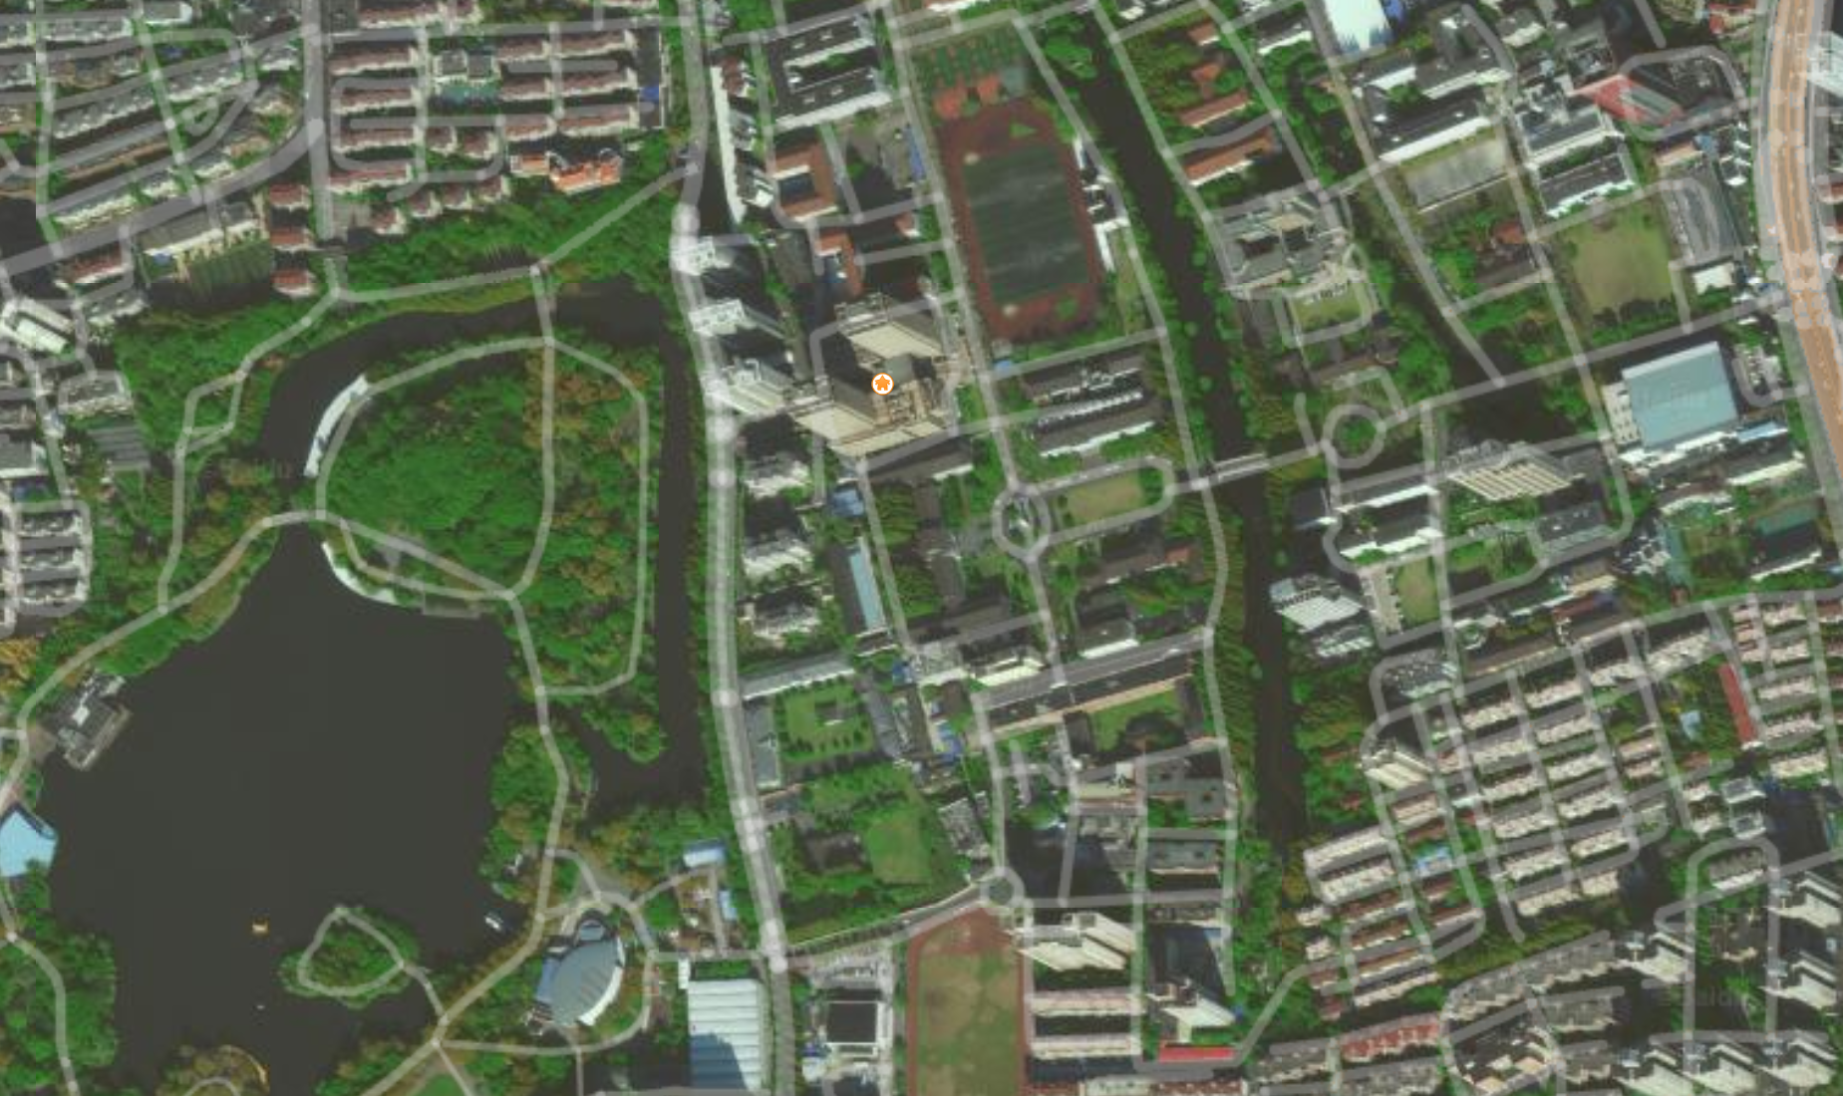
选题四
第三，本项目的特色在于，我们最终的测试数据不是在同一个高度拍摄的卫星图片，简单来说，如果输入的是亚洲的卫星图片，那么需要统计的是青海湖，黄河长江等等，如果输入的是上海的卫星图像，需要统计的是黄浦江等等，如果输入的是华师大的卫星图像，需要统计的是丽娃河等等。
深度学习框架建议为pytorch，TensorFlow
具体要求

Slide 18
Third, the feature of this project is that our final test data is not satellite images taken at the same altitude. In short, if we input satellite images of Asia, we need to count Qinghai Lake, Yellow River and Yangtze River, etc., if we input satellite images of Shanghai, we need to count Huangpu River, etc., if we input satellite images of ECNU, What needs to be counted is the Riva River and so on.
Recommend using pytorch，TensorFlow
Topic 4
Content

Slide 19
选题四
考核标准
该问题是一个比较“大”的问题，每一个“小”问题的完成情况与完成个数都是最终成绩的有力证明，不用担心最终结果不理想就只能获得不理想的成绩。每一个新颖的小想法，每一个被证明有效的小方法都可以获得高分
考核的首要指标是工程的完整情况，报告撰写的清晰情况。
考核的第二指标为面对上述的特殊情况，你的思考与新颖的想法。我们再次强调一个新颖的想法即使被证明效果不好，得分也会比拷贝别人的工作得分高

Slide 20
Topic 4
Assessment criteria
This problem is a relatively "big" problem. The completion of each "small" problem and the number of completed problems are strong proof of the final results. You can only get the unsatisfactory results without worrying about the final results. Every new idea, every small method that has been proved effective can get high scores
The second criteria of assessment is your thinking and new ideas in the face of the above special circumstances. Once again, we emphasize that even if a novel idea is proved to be ineffective, it will score higher than copying others' work

Slide 21
选题五：男（女）人数统计
Topic 5: Statistics of the number of men (women)

Slide 22
选题五
题目简介
利用深度学习技术，统计输入图片中男性（女性）的个数
对于一张输入的图片，统计人脸个数是一项成熟的工作，但我们不希望大家拿来别人的代码复现。我们希望大家利用自己的知识完成特定场景的迁移，所以准确性是我们考核的指标，但不是最重要的一个。该项目我们只统计图片中的男性（女性）个数。大家从数据标注工作开始，一直做到最终的成果，这个全流程会被认为是更重要的事情
如果能同时统计出男女个数，将会得到一个更具竞争力的成绩
自行构建的数据集要最终提交。数据标注的方式及其理由也是成绩考察的一部分。
深度学习框架建议为pytorch，TensorFlow
具体要求

Slide 23
Topic 5
Brief
Count the number of men (women) in the input picture by using deep learning technology
For an input image, it is a mature job to count the number of faces, but we don't want you to use other people's code to reproduce. We hope that you can use your knowledge to complete the migration of specific scenarios, so accuracy is our assessment indicator, but not the most important one. In this project, we only count the number of men (women) in the picture. Everyone starts from data annotation and always achieves the final result. This whole process will be considered as a more important thing
If you can count the number of men and women at the same time, you will get a more competitive score
The self-built dataset shall be finally submitted. The way of data annotation and its reasons are also part of the performance evaluation.
Recommend using pytorch，TensorFlow
Content

Slide 24
选题六：探索图片通道数在对象识别中的作用（研究性）
Topic 6: the role of image channel number in object recognition

Slide 25
选题六
题目简介
在对象识别任务中，输入图片有彩色图有灰度图（即：通道数不同），请从数学角度分析其各自的优劣，并提供实验证明？
该题目希望大家对深度学习本身进行探索，聚焦在网络输入层的图片通道数对结果的影响上。数学上的说明（猜想）与实验上的验证对于该题目是并重的。
训练集中的猫，狗，人两类的图片每种数量均不作限制，也不对训练预训练模型的数据集规模做要求。也不对彩色图片，灰度图片的数量做限制。请同学们各自收集数据集中的猫，狗，人的图片数据需最终提交。其他训练数据不需提交。图片保存格式应为普通图片格式（png,jpg）。
深度学习框架建议为pytorch，TensorFlow
具体要求

Slide 26
Topic 6
In the task of object recognition, the input image has color image and gray-scale image (i.e. different number of channels). Please analyze their advantages and disadvantages from a mathematical point of view and provide experimental proof?
Brief
We hope that you can explore the deep learning itself, focusing on the impact of the number of image channels in the network input layer on the results. The explanation (conjecture) in mathematics and the verification in experiment are equally important to the problem.
There is no limit to the number of pictures of cat, dog and human in the training set, and there is no requirement for the data set size of the training pre training model. There is no limit to the number of color pictures and gray-scale pictures. Please collect the pictures of cats, dogs and people in the dataset and submit them finally. Other training data do not need to be submitted. The image saving format should be normal image format (PNG, JPG).
Recommend using pytorch，TensorFlow
Content

Slide 27
选题六
考核的首要指标是工程的完整情况，报告撰写的清晰情况。
考核的第二指标为对深度学习的探索态度，与探索过程中体现的数学逻辑
考核的第三指标为实验的科学性，结果分析的合理性，与自身理论的紧密性。
考核标准
提交文件
大作业报告（.doc/.pdf）。包括但不限于代码运行指南，算法描述，文件组织结构，结果展示等
工程代码
数据集
上述文件打包压缩为（.zip）

Slide 28
Topic 6
The primary criteria of assessment is the completion of the project and the clearance of report writing.
The second criteria of assessment is the attitude of exploration to deep learning and the mathematical logic embodied in the process of exploration
The third index of assessment is the scientificity of experiment, the rationality of result analysis and the closeness of its own theory.
Assessment criteria
Deliverable
Report fille（.doc/.pdf）。Including but not limited to code operation guide, algorithm description, file organization structure, result display, etc
Code
dataset
Compress all file into（.zip）

Slide 29
选题七：基于MNIST数据集的异常值检测
Topic 7：Outlier detection based on MNIST data set

Slide 30
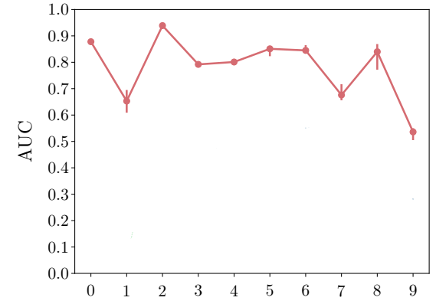
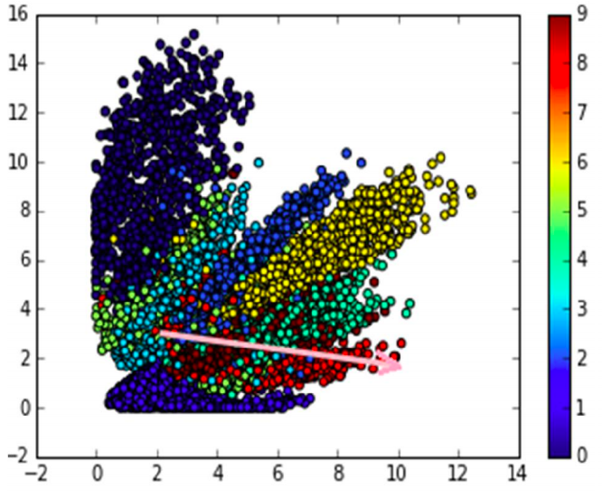
MNIST数据集数字0-9训练集60000张，测试集10000张，28*28大小。设置其中某位数字为异常值，
其他9位数字为正常值。例如当设置1为异常值时，0，2，3，4，5，6，7，8，9为正常值，
训练集正样本为【0，2，3，4，5，6，7，8，9】 负样本为【1】
测试集正样本为【0，2，3，4，5，6，7，8，9】 负样本为【1】

Slide 31
There are 60000 training sets, 10000 test sets and 28 * 28 size MNIST data sets. Set one digit as the abnormal value and the other nine digits as the normal value. For example, when 1 is set as abnormal value, 0, 2, 3, 4, 5, 6, 7, 8, 9 are normal values,
The positive sample of training set is [0, 2, 3, 4, 5, 6, 7, 8, 9] and the negative sample is [1]
The positive sample of the test set is [0, 2, 3, 4, 5, 6, 7, 8, 9] and the negative sample is [1]

Slide 32
选题八：基于活体检测数据集的二分类问题
Topic 8: binary classification based on liveness detection dataset

Slide 33
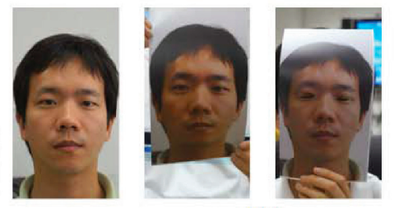
数据集中存在正负样本，正样本为视频前正常的人脸，负样本为视频前的假脸(打印的人脸), 通过传统方法或者深度学习方法进行二分类。
训练集正样本为 10个正常脸视频 负样本为10个假脸视频
测试集正样本为 10个正常脸视频 负样本为10个假脸视频
ffmpeg 提取帧
有监督或无监督

Slide 34
There are positive and negative samples in the data set, positive samples are normal faces before the video, negative samples are fake faces before the video (printed faces), which are classified by traditional methods or deep learning methods.
Positive samples of training set are 10 normal face videos, negative samples are 10 fake face videos
Positive samples of test set are 10 normal face videos, negative samples are 10 fake face videos
ffmpeg Extraction frame
Supervised or unsupervised

Slide 35

THANKS

